Slide 1
Basic ICP and K8S

Slide 2
Container Orchestration

Slide 3

Everyone’s container journey starts with one container….

Slide 4
At first the growth is easy to handle….

Slide 5
But soon you have many applications, many instances…

Slide 6
And that is why we have Container orchestration

Slide 7
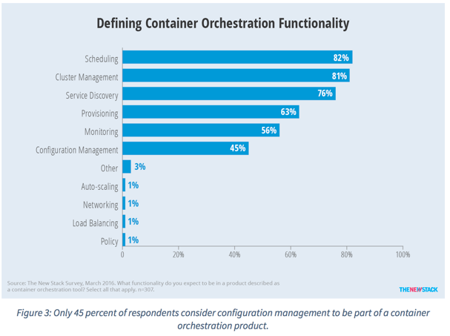
Container Orchestration Responsibilities
Container orchestration
Scheduling
Cluster management
Service discovery
Related functionality
Provisioning
Monitoring
Configuration management

Slide 8

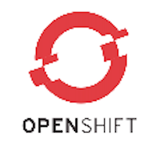
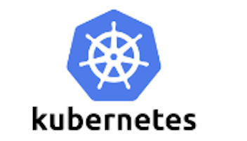


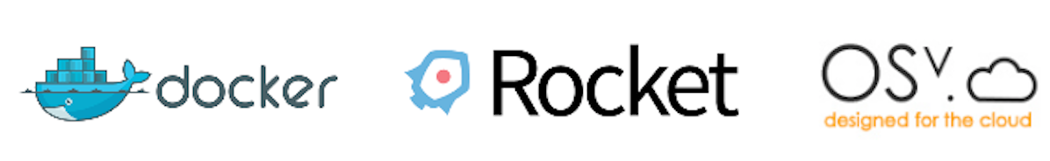

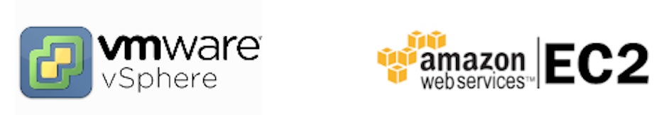
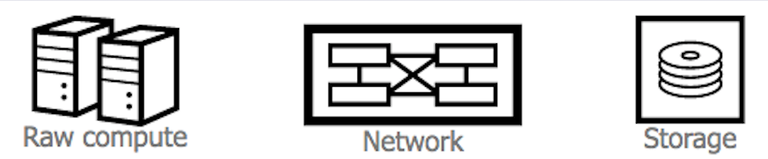
Container Ecosystem Layers
Layer 6
Development Workflow
Opinionated Containers
Layer 5
Orchestration/Scheduling
Service Model
Layer 4
Container Engine
Layer 3
Operating System
Layer 2
Virtual Infrastructure
Layer 1
Physical Infrastructure

Slide 9
What is container orchestration?
Container orchestration
Manages the deployment, placement, and lifecycle of workload containers
Cluster management
Federates multiple hosts into one target
Scheduling
Distributes containers across nodes
Service discovery
Knows where the containers are located
Distributes client requests across the containers
Replication
Ensures the right number of nodes and containers
Health management
Replaces unhealthy containers and nodes
Container Orchestrator
Manager
Image Repository
Scheduler
Discovery DB
Replicator
Node
Node
Node
Daemon
Daemon
Daemon
Containers
Containers
Containers

Slide 10
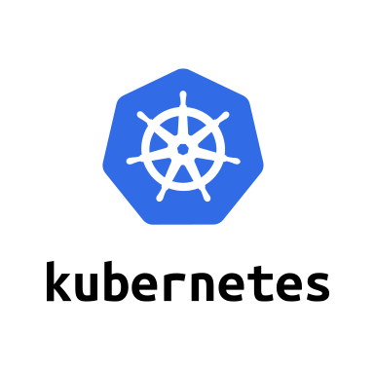
Introduction to Kubernetes

Slide 11
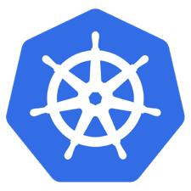
What is Kubernetes?
Container orchestrator
Runs and manages containers
Unified API for deploying web applications, batch jobs, and databases
Maintains and tracks the global view of the cluster
Supports multiple cloud and bare-metal environments
Manage applications, not machines
Rolling updates, canary deploys, and blue-green deployments
Designed for extensibility
Rich ecosystem of plug-ins for scheduling, storage, networking
Open source project managed by the Linux Foundation
Inspired and informed by Google's experiences and internal systems
100% open source, written in Go

Slide 12
Kubernetes Strengths
Kubernetes has a clear governance model
A growing and vibrant Kubernetes ecosystem
The commercial viability of Kubernetes makes it an interesting choice for vendors.
Despite the expected growth in commercial distributions, Kubernetes avoids dependency and vendor lock-in
Kubernetes supports a wide range of deployment options.
The design of Kubernetes is more operations-centric

Slide 13
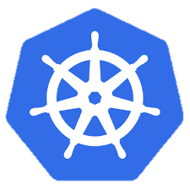
Kubernetes Cluster Architecture
internet
Master node
Node that manages the cluster
Scheduling, replication & control
Multiple nodes for HA
Worker nodes
Node where pods are run
Docker engine
kubelet agent accepts & executes commands from the master to manage pods
cAdvisor – Container Advisor provides resource usage and performance statistics
kube-proxy – routes inbound or ingress traffic
kubectl
firewall
Kubernetes cluster
Worker node
kube-proxy
kubelet
docker
pod
pod
pod
Master node
pod
pod
pod
cAdvisor
container
container
authentication authorization
container
container
APIs
container
scheduling
actuator
REST
Worker node
kube-proxy
controller manager
kubelet
Distributed watchable storage (etcd)
docker
pod
pod
pod
pod
pod
pod
cAdvisor
container
container
container
container
container

Slide 14
Master Node Components
Etcd
A highly-available key value store
All cluster data is stored here
API Server
Exposes API for managing Kubernetes
Used by kubectrl CLI
Controller manager
Daemon that runs controllers, which are the background threads that handle routine tasks in the cluster
Node Controller – Responsible for noticing and responding when nodes go down
Replication Controller – Replaced by ReplicaSet
Endpoints Controller – Populates the Endpoints object (that is, joins services and pods)
Service Account & Token Controllers – Create default accounts and API access tokens for new namespaces
Scheduler
Selects the worker node each pods runs in

Slide 15
Kubernetes Architecture: How apps are accessed
Pod
Smallest deployment unit – runs containers
Each pod has its own IP
Shares a PID namespace, network, and hostname
Service
Collection of pods exposed as an endpoint
state and networking info propagated to all worker nodes
Types of service exposure
ClusterIP – Exposes cluster-internal IP
NodePort – Exposes the service on each Node’s IP at a static port
LoadBalancer – Exposes externally using a cloud provider’s load balancer
ExternalName – Maps to an external name (such as foo.bar.example.com)
Kubernetes components
Master Node
Worker Node 1
Pod
Pod
App A
App B
App A Client
App A Service
Worker Node 2
Pod
Pod
App B
App A
App B Client
App B Service
Worker Node 3
Pod
Pod
App A
App B

Slide 16
Deployments & ReplicaSets
Deployment
A set of pods to be deployed together, such as an application
Declarative: Revising a Deployment creates a ReplicaSet describing the desired state
Rollout: Deployment controller changes the actual state to the desired state at a controlled rate
Rollback: Each Deployment revision can be rolled back
Scale and autoscale: A Deployment can be scaled
ReplicaSet
The next-generation ReplicationController
A set of pod templates that describe a set of pod replicas
Uses a template that describes specifically what each pod should contain
Ensures that a specified number of pod replicas are running at any given time
Deployment
create
ReplicaSet 1
Deployment
rollback
rollout
ReplicaSet 1
ReplicaSet 2
rolling update
pod
pod
pod
ReplicaSet 2
svcA
svcA
svcB
Notes:
https://kubernetes.io/docs/concepts/workloads/controllers/deployment/
https://kubernetes.io/docs/concepts/workloads/controllers/replicaset/
https://kubernetes.io/docs/user-guide/kubectl/v1.6/#rollout
https://kubernetes.io/docs/user-guide/kubectl/v1.6/#rolling-update
https://kubernetes.io/docs/concepts/cluster-administration/manage-deployment/#canary-deployments
Blue-green deployment isn’t built-in to Kubernetes (as of July 2017). Some examples others have built:
https://techbeacon.com/one-year-using-kubernetes-production-lessons-learned
http://www.devoperandi.com/kubernetes-deployment-resource-bluegreen-deploys-for-everyone/

Slide 17
Kubernetes Autoscaling
Horizontal Pod Autoscaling (HPA)
Automatically scales the number of pods in a replication controller, deployment, or replica set
Matches the observed average CPU utilization to the specified target
Fetches metrics in two different ways: direct Heapster access and REST client access
Kubernetes Heapster enables container cluster monitoring and performance analysis
Default config: query every 30 sec, maintain 10% tolerance, wait 3 min after scale-up, wait 5 min after scale-down
$ kubectl autoscale deployment <deployment-name> --cpu-percent=50 --min=1 --max=10 deployment ”<hpa-name>" autoscaled
Creates a horizontal pod autoscaler
An HPA instance
Maintains between 1 and 10 replicas of the pods controlled by the deployment
Maintains an average CPU utilization across all pods of 50%
Notes:
https://kubernetes.io/docs/tasks/run-application/horizontal-pod-autoscale/
https://kubernetes.io/docs/tasks/run-application/horizontal-pod-autoscale-walkthrough/
https://kubernetes.io/docs/user-guide/kubectl/v1.6/#autoscale
https://github.com/kubernetes/community/blob/master/contributors/design-proposals/horizontal-pod-autoscaler.md

Slide 18
Naming
Name
Each resource object by type has a unique name
Namespace
Resource isolation: Each namespace is a virtual cluster within the physical cluster
Resource objects are scoped within namespaces
Low-level resources are not in namespaces: nodes, persistent volumes, and namespaces themselves
Names of resources need to be unique within a namespace, but not across namespaces
Resource quotas: Namespaces can divide cluster resources
Initial namespaces
default – The default namespace for objects with no other namespace
kube-system – The namespace for objects created by the Kubernetes system
Resource Quota
Limits resource consumption per namespace
Limit can be number of resource objects by type (pods, services, etc.)
Limit can be total amount of compute resources (CPU, memory, etc.)
Overcommit is allowed; contention is handled on a first-come, first-served basis

Slide 19
Configuring Resources and Containers
Label
Metadata assigned to Kubernetes resources (pods, services, etc.)
Key-value pairs for identification
Critical to Kubernetes as it relies on querying the cluster for resources that have certain labels
Selector
An expression that matches labels to identify related resources
ConfigMap
Configuration values to be used by containers in a pod
Stores configuration outside of the container image, making containers more reusable
Secret
Sensitive info that containers need to read or consume
Encrypted in special volumes mounted automatically

Slide 20
Kubernetes Management Architecture
UI
Master Node
Worker Node 1
Worker Node 2
API
Worker Node 3
CLI
Worker Node n
Registry
Etcd
API Server
Controller Manager Server
Scheduler

Slide 21
Kubectl Commands
Get the state of your cluster
$ kubectl cluster-info
Get all the nodes of your cluster
$ kubectl get nodes -o wide
Get info about the pods of your cluster
$ kubectl get pods -o wide
Get info about the replication controllers of your cluster
$ kubectl get rc -o wide
Get info about the services of your cluster
$ kubectl get services
Get full config info about a Service
$ kubectl get service NAME_OF_SERVICE -o json
Get the IP of a Pod
$ kubectl get pod NAME_OF_POD -template={{.status.podIP}}
Delete a Pod
$ kubectl delete pod NAME
Delete a Service
$ kubectl delete service NAME_OF_SERVICE

Slide 22
Resources
Kubernetes tutorial
https://kubernetes.io/docs/tutorials/kubernetes-basics/
Introduction to container orchestration
https://www.exoscale.ch/syslog/2016/07/26/container-orch/
TNS Research: The Present State of Container Orchestration
https://thenewstack.io/tns-research-present-state-container-orchestration/
Large-scale cluster management at Google with Borg
https://research.google.com/pubs/pub43438.html

Slide 23
ICp

Slide 24


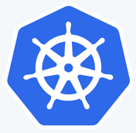
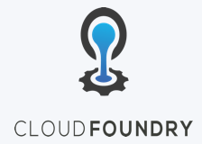
IBM Cloud Private – what is it ?
IBM Middleware, Data, Analytics and Developer Services
Cloud enabled middleware, messaging, databases, analytics, and cognitive services to optimize current investments while rapidly innovating
Enterprise grade services for Middleware, Data, Analytics, DevOps
Core Operational Services Simplify Operations Management, Security, and Hybrid integration Provision infrastructure and apps across Multi-Cloud environments
Enterprise grade operations, across your Hybrid IT environment
Kubernetes-based Container Platform
Industry leading container orchestration platform across private, dedicated & public clouds
Cloud Foundry
For prescribed app development & deployment
Open by design, preventing vendor lock-in
Leverage existing investments
Runs on existing IaaS:
System Z
IBM Spectrum
CMS
Third Party alliances:
Dell Cisco NetApp Lenovo Canonical …

Slide 25
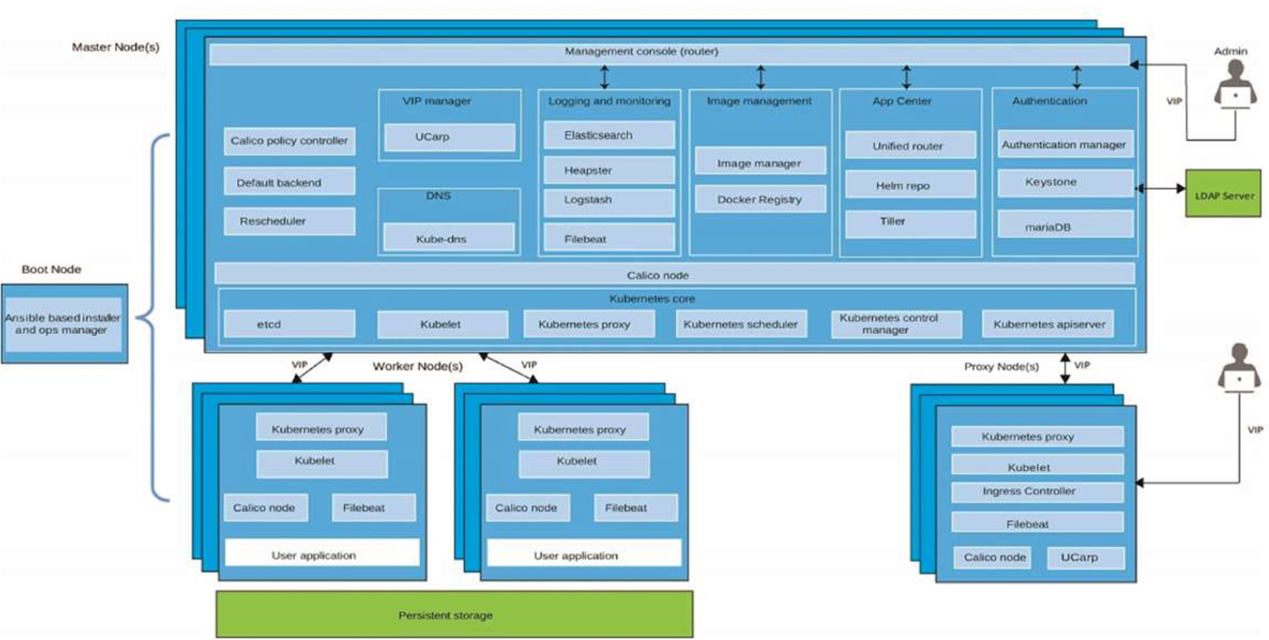
IBM Cloud Private – architecture components
Notes:
Go out and define each one of these components and maybe animate the whole thing
Need the slide source or completely rebuild slide with 2.1 changes

Slide 26
ICP – types of nodes
Boot node: A boot or bootstrap node is used for running installation, configuration, node scaling, and cluster updates. Only one boot node is required for any cluster. You can use a single node for both master and boot.
Master node: A master node provides management services and controls the worker nodes in a cluster. Master nodes host processes that are responsible for resource allocation, state maintenance, scheduling, and monitoring. Multiple master nodes are in a high availability (HA) environment to allow for failover if the leading master host fails. Host that can act as the master are called master candidates.
Worker node: A worker node is a node that provides a containerized environment for running tasks. As demands increase, more worker nodes can easily be added to your cluster to improve performance and efficiency. A cluster can contain any number of worker nodes, but a minimum of one worker node is required.
Proxy Node: A proxy node is a node that transmits external request to the services created inside your cluster. Multiple proxy nodes are deployed in a high availability (HA) environment to allow for failover if the leading proxy host fails. While you can use a single node as both master and proxy, it is best to use dedicated proxy nodes to reduce the load on the master node. A cluster must contain at least one proxy node if load balancing is required inside the cluster.

Slide 27
Configuration topologies
Worker Node
Docker
Simple
Single machine install (master is a worker)
Great for testing and learning about the platform
Standard
Single master (single master, 3 workers, 1 proxy)
Great for non-production testing environment
High Availability
Multiple masters (3 masters, 3+ workers, 3 proxy)
Production installation
Pod
Pod
Pod
Container
Container
Container
Container
Container
Container
Master
Worker Node
Docker
Pod
Pod
Pod
Container
Container
Container
Container
Container
Container
Worker Node
Proxy Node
Docker
Pod
Pod
Pod
Container
Container
Container
Container
Container
Container

Slide 28
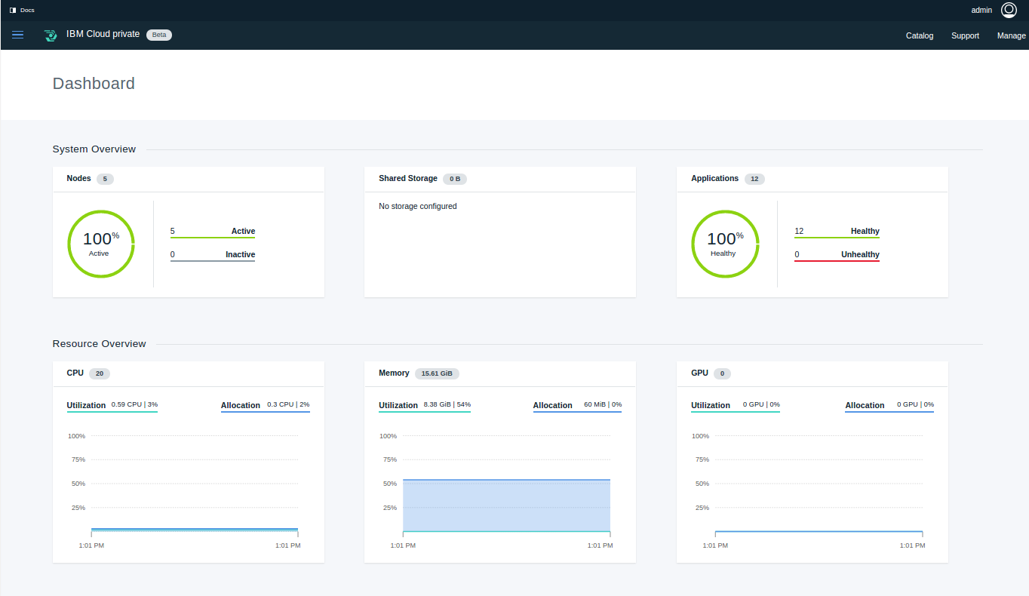
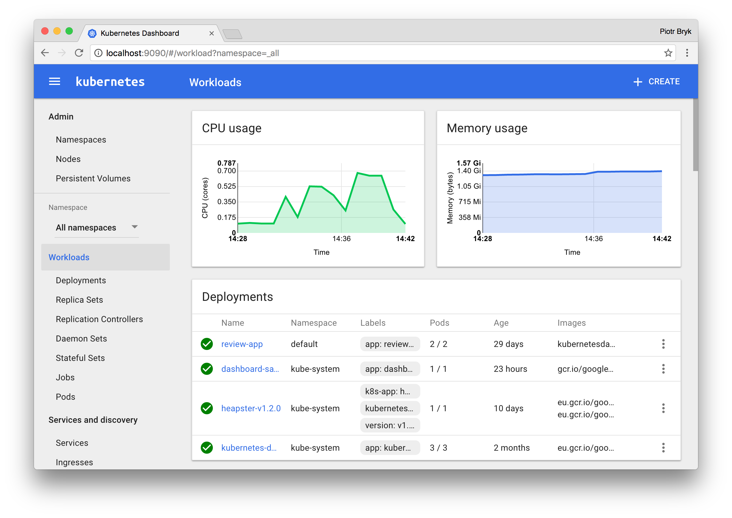
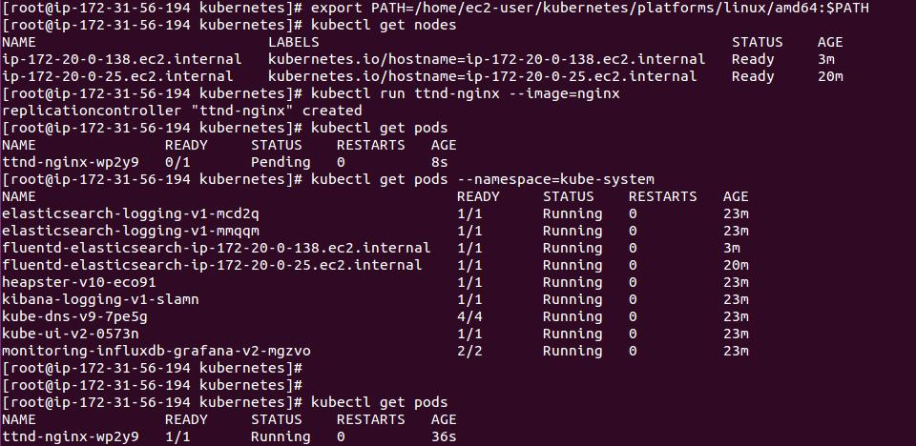
User Interfaces
Cluster Management Console: (ICP component) Use to manage, monitor, and troubleshoot your applications and cluster from a single, centralized, and secure management console.
K8s Web UI: Can use to deploy containerized applications to a Kubernetes cluster, troubleshoot your containerized application, and manage the cluster itself along with its attendant resources.
kubectl: A command-line interface for running commands against Kubernetes clusters.

Slide 29

Calico
A new approach to virtual networking and network security for containers, VMs, and bare metal services, that provides a rich set of security enforcement capabilities running on top of a highly scalable and efficient virtual network
The calico/node Docker container runs on the Kubernetes master and each Kubernetes node in the cluster
The calico-cni plug-in integrates directly with the Kubernetes kubelet process on each node to discover which pods have been created, and adds them to Calico networking
The calico/kube-policy-controller container runs as a pod on top of Kubernetes and implements the NetworkPolicy API
Notes:
Pure layer 3 cloud networking solution
Distribute routes using BGP protocol, with route reflectors for scale
Leverage linux kernel’s efficient IP forwarding engine
Translate global policy into distributed firewall on each host, enabling tenant isolation

Slide 30
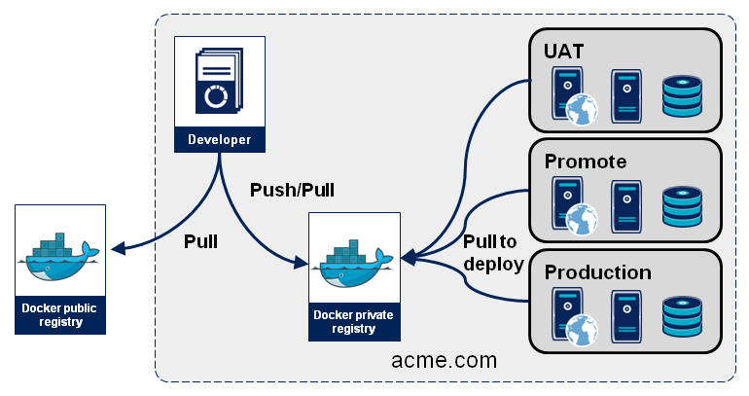
Images and Registries
You create a Docker image and push it to a registry before referring to it in a Kubernetes pod
There will likely be many registries used in your deployment
Notes:
Rework this with public and private registries

Slide 31
Storage in ICp

Slide 32
Persistent storage components (1 of 2)
Traditionally Containers: stateless, ephemeral in nature
Storage exists within the container
The container goes away and so goes the storage
Some applications desire state and thus persistent storage:
Specific aspects of configuration
Database (structured and unstructured)
Application data (website definitions, etc.)
Storage must be universally accessible across the K8s environment

Slide 33
Persistent storage components (2 of 2)
ICP Persistent Storage Support: HostPath, NFS, GlusterFS, vSphereVolume
Note: Reclaim policy and access modes and behaviors can vary
Access Modes:
ReadWriteOnce – the volume can be mounted as read-write by a single node
ReadOnlyMany – the volume can be mounted read-only by many nodes
ReadWriteMany – the volume can be mounted as read-write by many nodes
Notes:
Other popular providers not in support
CephFS
Google (GCE PersistentDisk)
AWS (ElasticBlockStore)
Azure (Azurefile, AzureDisk)
Cinder
FC
FlexVolume
Flocker
iSCSI
Quobyte
VspherVolume
Etc.

Slide 34
Volumes, persistent and temporary
A container file system only lives as long as the container does. When a container terminates, any data stored within the container is lost.
You must create a volume if the container needs persistent storage
Various types of data can be mounted as volume (e.g. Configmaps, Secrets, HostPath, ServiceAccount, etc.)
You can create several types of persistent storage
apiVersion: v1
kind: Pod
metadata:
name: redis
spec:
containers:
- name: redis
image: redis
volumeMounts:
- name: redis-persistent-storage
mountPath: /data/redis
volumes:
- name: redis-persistent-storage
emptyDir: {}

Slide 35
Persistent volumes and how they are created
A PersistentVolume (PV) is a piece of storage in the cluster that has been provisioned by an administrator. It is a resource in the cluster just like a node is a cluster resource. Persistent volumes can be provisioned in one of two ways:
Statically -- A cluster administrator creates a number of PVs. They carry the details of the real storage which is available for use by cluster users. They exist in the Kubernetes API and are available for consumption.
Dynamically -- When none of the static PVs the administrator created matches a user’s PersistentVolumeClaim, the cluster may try to dynamically provision a volume specially for the PVC. This provisioning is based on StorageClasses. The PVC must request a class and the administrator must have created and configured that class in order for dynamic provisioning to occur.

Slide 36
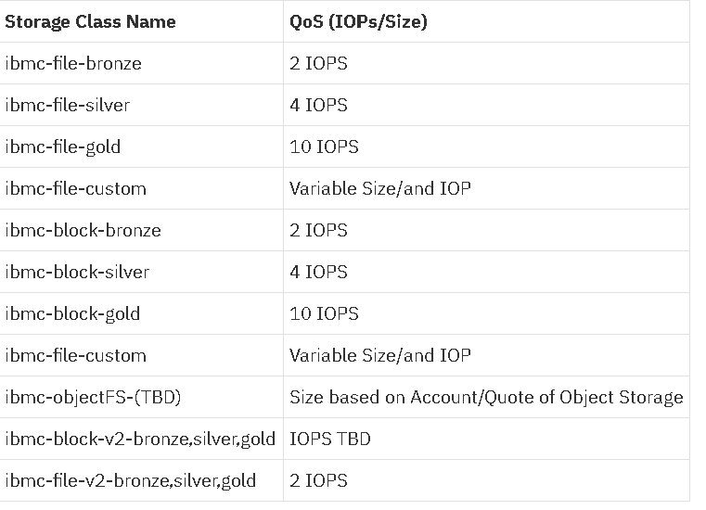
Dynamic storage provisioning
For more information, see:
https://www.ibm.com/support/knowledgecenter/SSBS6K_2.1.0/installing/storage_class_all.html
Dynamic provisioning allows storage volumes to be created on-demand.
Use storage classes to provision volumes.
Different classes has different Input/output operations per second (IOPS)
Classes should be defined prior to installing ICp
Only Kubernetes storage classes are valid
Created *.yaml files for storage classes go in the installation folder.

Slide 37

GlusterFS
Network Attached Storage
POSIX-Compliant distributed file-system
Differentiator -> No central metadata server
Aggregator of storage and metadata
Flexible scaling for capacity and performance
NOTE: Red Hat Gluster Storage (formerly Red Hat Storage Server) is built upon the open source GlusterFS at gluster.org
Notes:
Portable Operating System Interface IEEE standard
Heterogeneous Commodity Hardware
Typical NAS has limited scalability and when they do they include metadata servers that tend to become a bottleneck
SAN obviously scales at a price

Slide 38
GlusterFS and Heketi
Heketi
Restful management interface for the management of GlusterFS volumes
For Kubernetes, it provides dynamic provisioning of volumes
You provide nodes with storage devices
Heketi assembles the topology
Manages life-cycle of bricks, volumes, etc
ICP + K8s Talk to Heketi
https://github.com/heketi/heketi
Trusted
Storage
Pool
Gluster:Node 1
Accept
Gluster:Node 2
Probe
Probe
Gluster:Node X
Accept

Slide 39
GlusterFS - common deployment architecture
K8s: Master Node
Pod-ased Components
Gluster pods Deployed to each K8s node
Heketi pod or pods deployed to K8s
Gluster Provisioner
K8s: Worker Node
K8s: Worker Node
App Pod
Heketi Pod
Heketi Pod
Gluster Mount Plugin
Storage Device
Gluster Pod (Daemon Set)
Storage Device
Gluster Pod (Daemon Set)
K8s: Worker Node
Heketi Pod
Storage Device
Gluster Pod (Daemon Set)

Slide 40
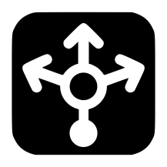
Enterprise architecture
ICP Cluster
Principle: Remove management and back-end from the platform
Heketi can be installed as pods or on HA IaaS
Allows storage solution life-cycle outside of ICP
K8s: Worker Node
K8s: Master Node
Heketi
App Pod
App Pod
Heketi
Heketi
Gluster Mount Plugin
Gluster Provisioner
Gluster Cluster
Gluster Node
Storage Device
K8s: Worker Node
K8s: Worker Node
Storage Device
Storage Device
Storage Device
Storage Device
Gluster Node
Gluster Node

Slide 41
Helm – next generation package manager

Slide 42
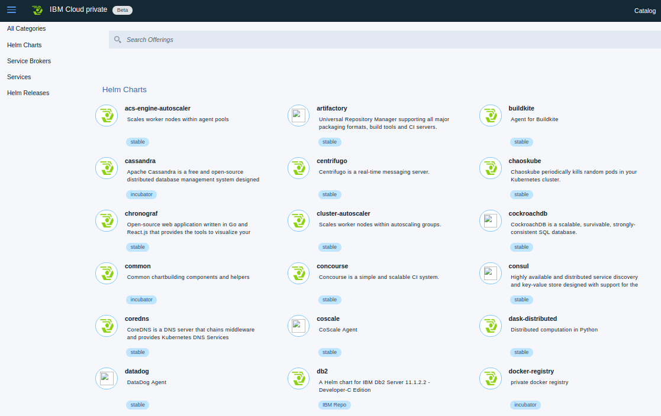
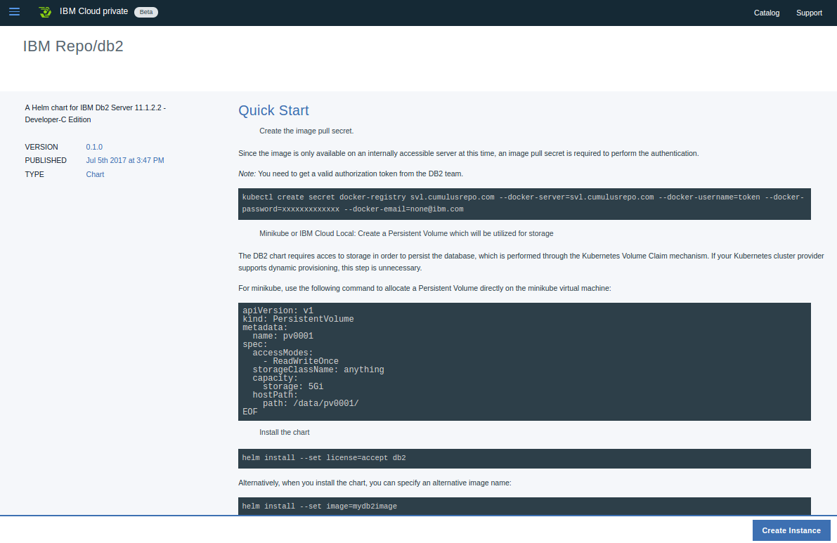
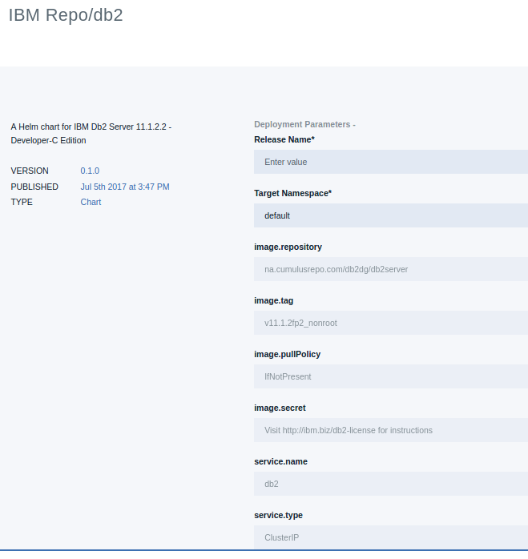
Application Center components
Application center provides a centralized location from which you can browse, and install packages in your cluster.
Helm: A tool for managing Kubernetes charts. Charts are packages of pre-configured Kubernetes resources.
Helm Repository: A Helm chart repository is a location where packaged charts can be stored and shared.
Tiller: Runs inside of the cluster, and manages releases (installations) of your charts.

Slide 43
Helm – A package manager for Kubernetes
What is a package manager?
Automates the process of installing, configuring, upgrading, and removing computer programs
Examples: Red Hat Package Manager (RPM), Homebrew, Windows Pkgmgr/PackageManagement
Helm enables multiple Kubernetes resources to be created with a single command
Deploying an application often involves creating and configuring multiple resources
A Helm chart defines multiple resources as a set
An application in Kubernetes typically consists of (at least) two resource types
Deployment – Describes a set of pods to be deployed together
Services – Endpoints for accessing the APIs in those pods
Could also include ConfigMaps, Secrets, Ingress, etc.
A default chart for an application consists of a deployment template and a service template
The chart creates all of these resources in a Kubernetes cluster as a set
Rather than manually having to create each one separately via kubectl
Notes:
Helm is a package Manager
Automates the installation, configuration, upgrade and removing of Apps
Deploys the App and its Configuration
The App and its Config are packaged in a so called Chart
At least two resource types: Deployment and Services (Secrets, ConfigMap)
You avoid creating each resource manually using kubectl

Slide 44

Helm Terminology
Helm – The CLI
Helm installs charts into Kubernetes, creating a new release for each installation
To find new charts, search Helm chart repositories
Chart – The application package
Templates for a set of resources necessary to run an application
The chart includes a values file that configures the resources
Repository – The library
Storage for Helm charts
stable – The namespace of the hub for official charts
Release – The application runtime
An instance of a chart running in a Kubernetes cluster
The same chart installed multiple times creates many releases
Tiller – The server-side engine
Helm templating engine, runs in a pod in a Kubernetes cluster
Tiller processes the chart to generate the resource manifests, then installs the release into the cluster
Tiller stores each release as a Kubernetes config map
Chart (templates)
Values (config)
install
Kubernetes cluster
Release
(resources)
Tiller
Notes:
Helm is the CLI
Helm creates a new release for each installation (versioning: rollback)
Chart is the application package
Repository is the library: Just a web server
Release is the application runtime: An instance of a Chart
Tiller is the server side. Runs in a pod.

Slide 45
Advantages of Using Helm
Deploy all of the resources for an application with a single command
Makes deployment easy and repeatable
$ helm install <chart>
Separates configuration settings from manifest formats
Edit the values without changing the rest of the manifest
values.yaml – Update to deploy the application differently
Upgrade a running release to a new chart version
$ helm upgrade <release> <chart>
Rollback a running release to a previous revision
$ helm rollback <release> <revision>
Delete a running release
$ helm delete <release>
Kubernetes cluster
Chart
myapp v1
install
Release
myapp r1
upgrade
rollback
Chart
myapp v2
(upgrade)
Release
myapp r2
delete
Notes:
Deploy all resources with a single command
Can use variables to deploy same App with new parameters
Upgrade to a new version of your chart
Rollback
Delete as a whole

Slide 46
Creating a Chart
Creating a new chart generates a directory with sample files
$ helm create my-chart $ tree my-chart
my-chart/ # The content of this directory is the chart |- Chart.yaml # Information about the chart |- values.yaml # The default configuration values for this chart |- charts/ # Charts that this chart depends on |- templates/ # This chart's template files |- NOTES.txt # OPTIONAL: A plain text file containing short usage notes |- _helpers.tpl # OPTIONAL: The default location for template partials |- deployment.yaml # Sample template for a deployment resource |- service.yaml # Sample template for a service resource
Chart starts with sample templates for a Kubernetes deployment and service
In the simplest case, just edit the values.yaml file
Notes:
Create a new chart using helm create my-chart
Go Language
The Chart starts with a sample template for a Kube deployment and service
You can start with editing values,yaml

Slide 47
Packaging Charts
A chart is a directory
Easy for a Helm client to use the chart directories on the same computer
Difficult to share with other users on other computers
Packaging a chart
Bundle Chart.yaml and related files into a tar file
$ helm package <chart-path> # Bundles chart directory into a tar file
$ helm install <chart-name>.tgz # Installs the chart in the chart file
Packaged charts can be shared in a chart repository
Sub-charts:
Chart can reference other charts using requirements.yaml file, these sub-charts will be installed with the current chart
Notes:
A chart is a directory
Is usually on a web server so you can share charts with others
Is called chart repository
You can package a chart into a tar file

Slide 48
Installing an Application
To deploy an application into Kubernetes, install that application’s Helm chart
$ helm search mysql
NAME VERSION DESCRIPTION stable/mysql 0.1.1 Chart for MySQL
$ helm install stable/mysql
Fetched stable/mysql to mysql-0.1.1.tgz NAME: loping-toad LAST DEPLOYED: Thu Oct 20 14:54:24 2016 NAMESPACE: default STATUS: DEPLOYED
RESOURCES: ==> v1/Secret NAME TYPE DATA AGE loping-toad-mysql Opaque 2 3s
==> v1/Service NAME CLUSTER-IP EXTERNAL-IP PORT(S) AGE loping-toad-mysql 192.168.1.5 <none> 3306/TCP 3s
==> extensions/Deployment NAME DESIRED CURRENT UP-TO-DATE AVAILABLE AGE loping-toad-mysql 1 0 0 0 3s
==> v1/PersistentVolumeClaim NAME STATUS VOLUME CAPACITY ACCESSMODES AGE loping-toad-mysql Pending
Install output
Details about the release
Details about its resources
Chart
stable/mysql
Release name
loping-toad (auto generated)
Resources
Four total, one of each type
All named loping-toad-mysql
Secret
Service
Deployment
PersistentVolumeClaim
Notes:
Search for a chart with helm search
Deploy a chart with helm install
See the resources created

Slide 49
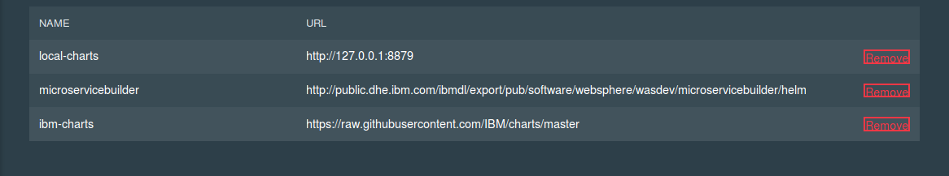
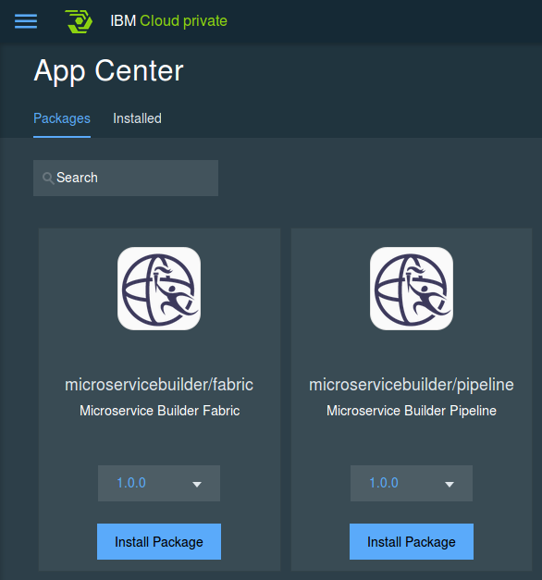
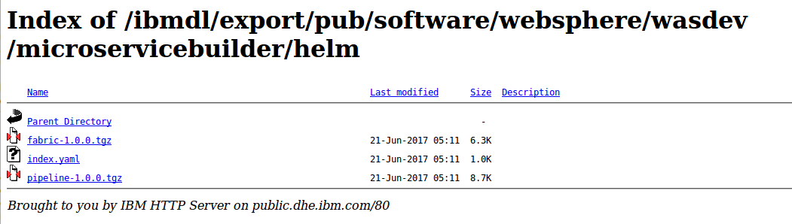
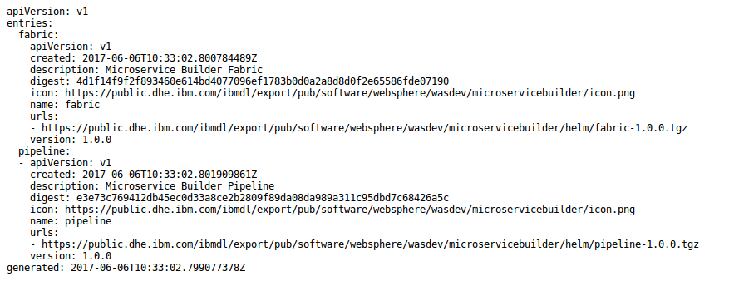
Chart repository
Chart repository:
HTTP server that houses an index.yaml file and optionally some packaged charts
Server can be any HTTP server that can serve YAML and tar files and can answer GET requests
To serve a local repo
$ helm serve
To add a chart to the repository, copy it to the directory and regenerate the index
$ helm repo index <charts-path>
Notes:
Chart repository is a web server with an index.yaml file
There are steps for adding a chart to a repository: copy, reindex
Also for the local repository in ICP
Adding your chart to local-repo:
on master, get helm container using `docker ps | grep helm`
copy your chart using `docker cp x.tar.gz <dockerID>:/local-repo`
Restart the container using docker restart <helm container id>
go to dashboard, click sync up repo, you will get your chart in app center

Slide 50
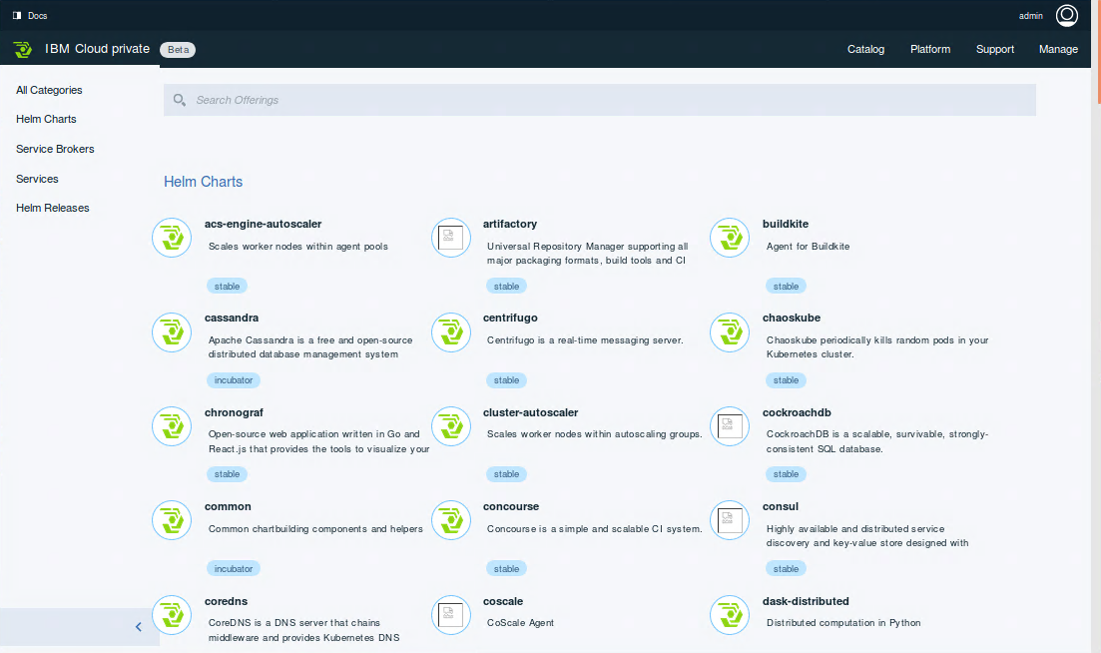
IBM Cloud Private catalog
https://<master>:8443/catalog
Chart repository:
HTTP server that houses an index.yaml file and optionally some packaged charts
Server can be any HTTP server that can serve YAML and tar files and can answer GET requests
To add a chart to the repository, use the ICp CLI to integrate it into the local repo
Notes:
Here is a sample catalog

Slide 51
Resources – Introduction
Helm - The Kubernetes Package Manager
https://helm.sh
https://docs.helm.sh
https://github.com/kubernetes/helm
https://github.com/kubernetes/helm/blob/master/docs/index.md
Taking the Helm: Delivering Kubernetes-Native Applications by Michelle Noorali (KubeCon 2016)
https://www.youtube.com/watch?v=zBc1goRfk3k
Installing Helm
https://docs.helm.sh/using_helm/#installing-helm
Notes:
Resources

Slide 52
Let’s talk specific on the white board

